Slide 1


Slide 2


Slide 3
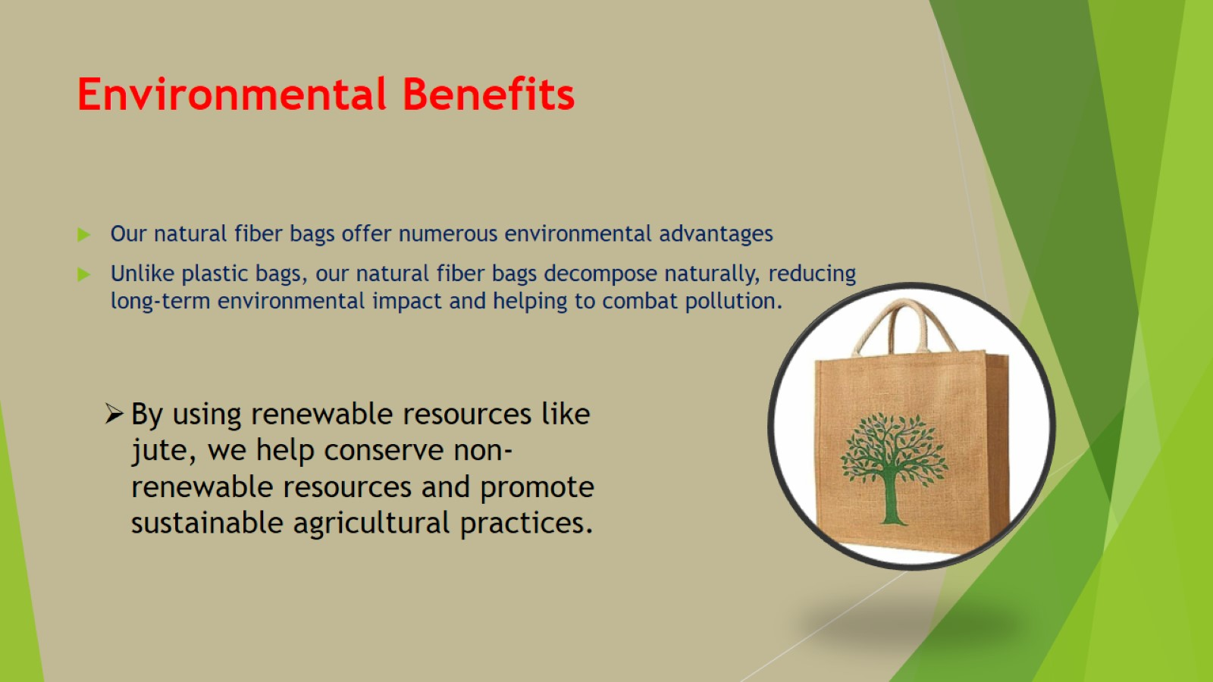
Environmental Benefits

Slide 4

Economic and Social Impact

Slide 5

Health and Safety

Slide 6
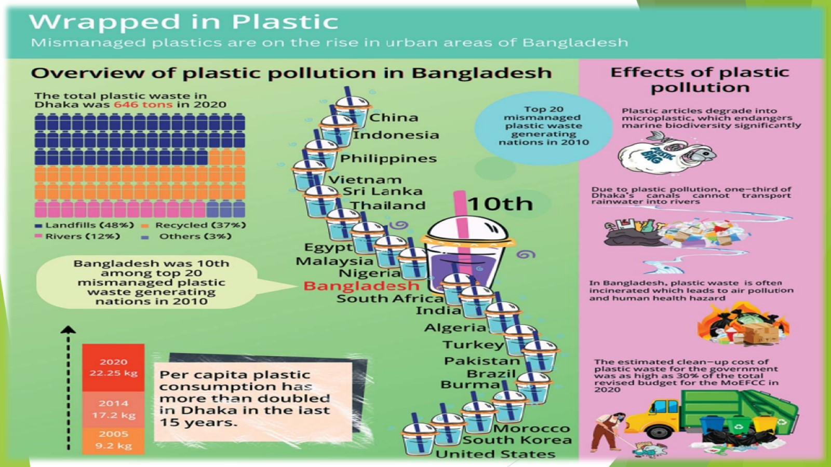

Slide 7


Slide 8
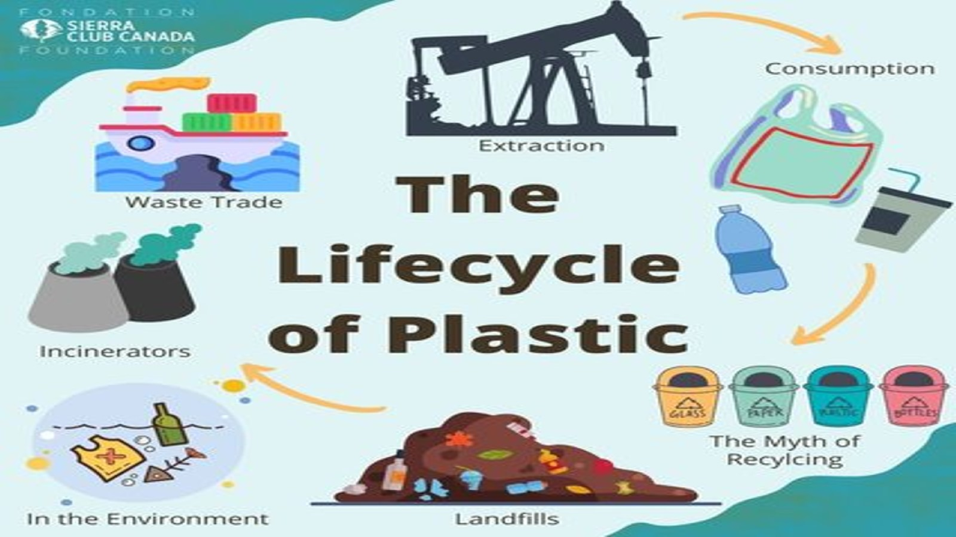

Slide 9
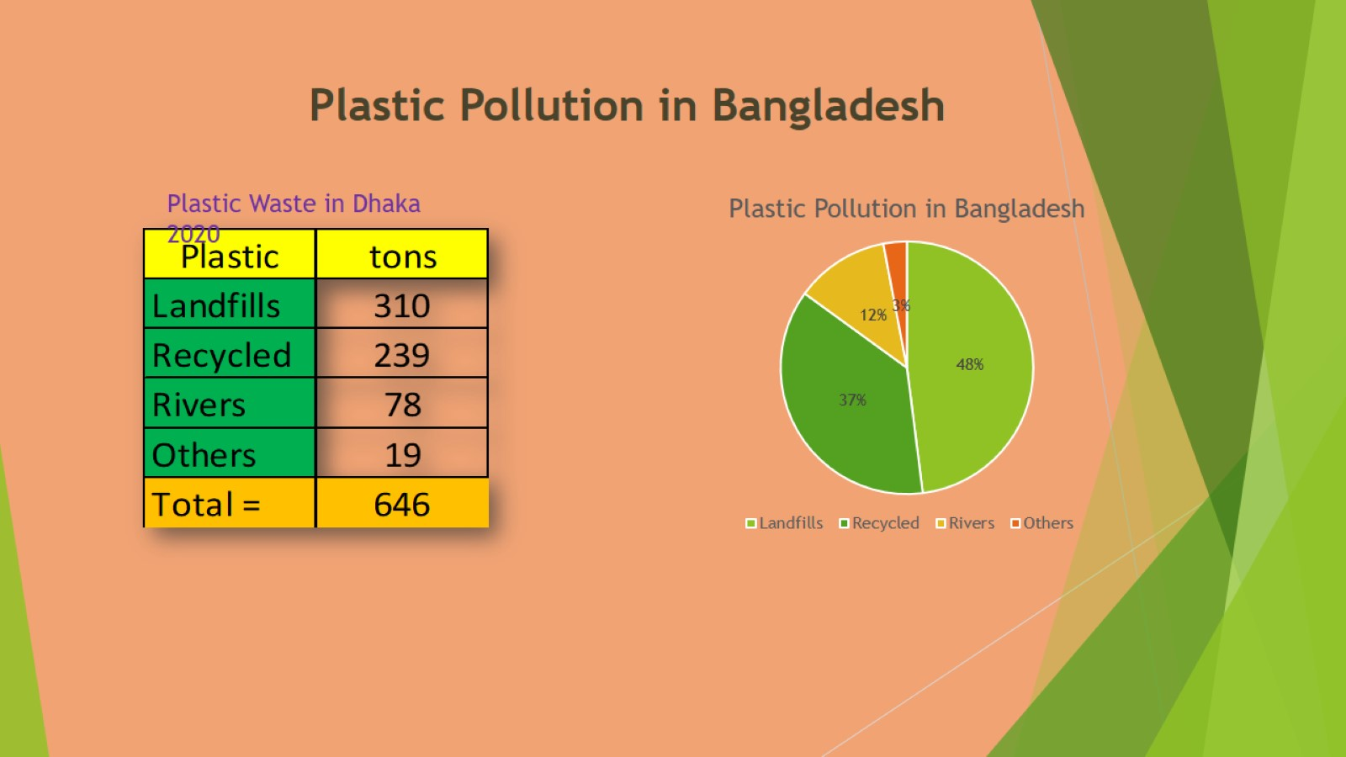

Slide 10
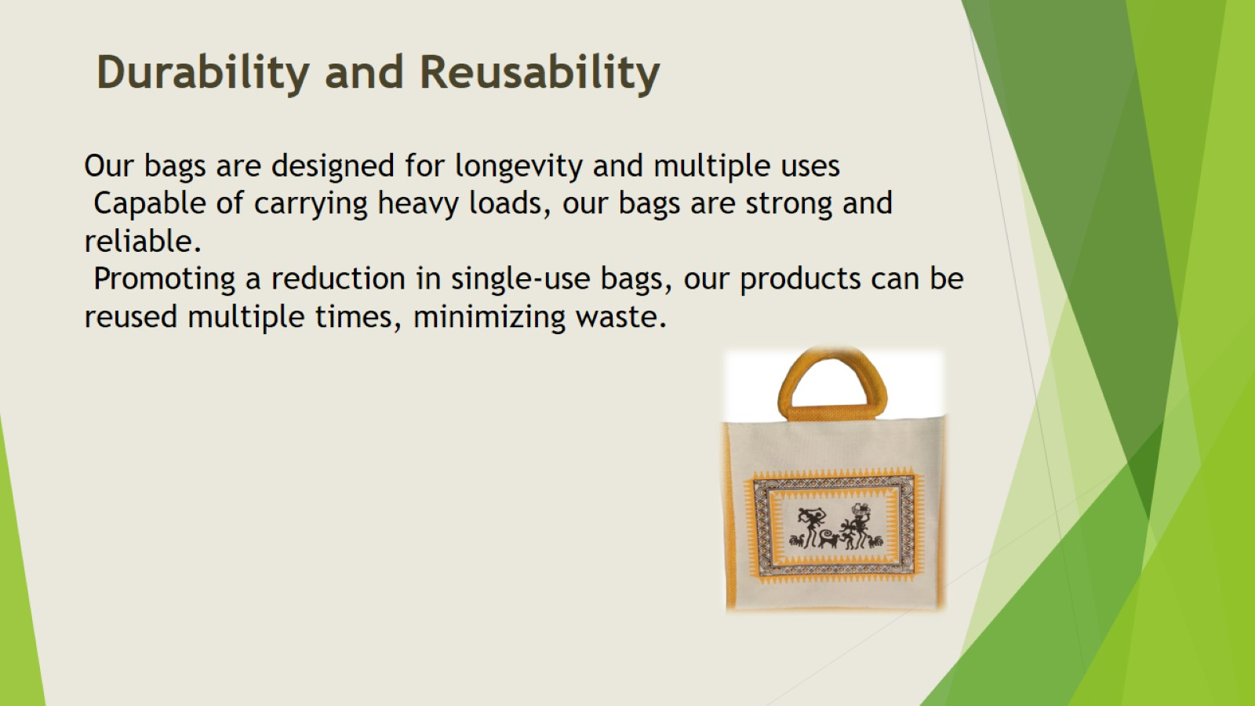
Durability and Reusability

Slide 11

Cultural and Community Benefits

Slide 12
